Slide 1
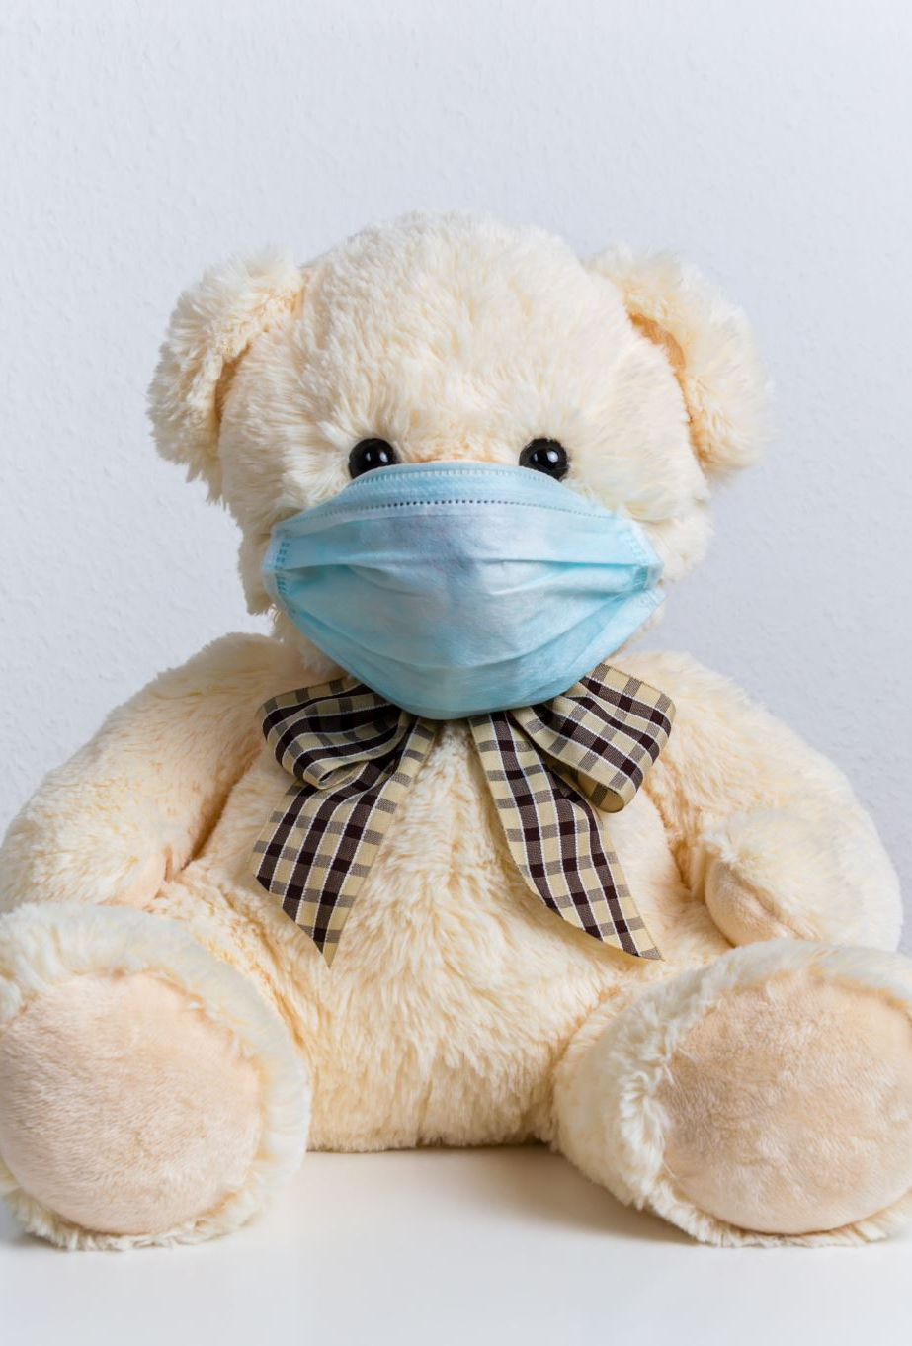
COVID-19 Pandemic “A time of change”
Rajiv Wickramaratne
Liam Twomey
Angela Alexander Smith
Project Group 5

Slide 2

World Covid Data “owid-covid-data.csv”
COVID-19 has had a massive impact on the way we lived our lives over the past 2 years. It has impacted the way we socialize, study and work… and introduced the way overstated phase of “Can you see my screen
Public opinion is determined via news & social media but what does the data say?
Governments around the world have responded to the COVID-19 Pandemic in varied ways but what was the impact of Government measures and lifestyle factors on how the pandemic played out

Slide 3
“owid-covid-data.csv”
Started with a massive csv
Data recorded starting in 2020 all the way through to 2022
207316 rows and 67 columns of data
Multiple columns need to be cleaned for data usability

Slide 4
The data tells the story
Question 1
Do countries with lower GDP’s, reduced services and a lower life expectancy show a higher COVID-19 related death rate or is the inverse true where a higher life expectancy and therefore an aging population inflate these numbers
Question 2
How did the stringency of the measures enforced by the Government impact the spread of COVID-19 pre vaccination measures.
Question 3
How did the availability of vaccinations influence the trends in COVID-19 case numbers and deaths

Slide 5
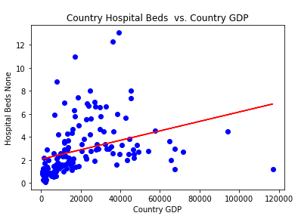
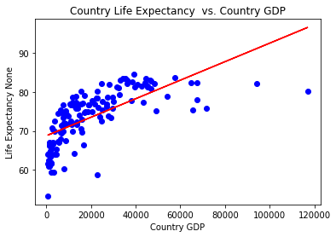
As expected we see a positive correlations between Country GDP vs Life expectancy (r value 0.455) as well as GDP vs hospital beds (per thousand population) (R value 0.113)

Slide 6
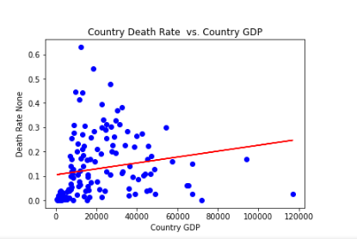
Country Death Rate does not correlate to the initial hypothesis that countries with a higher GDP would have lower death rates (R Value 0.033)

Slide 7
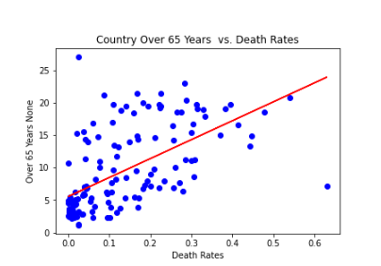
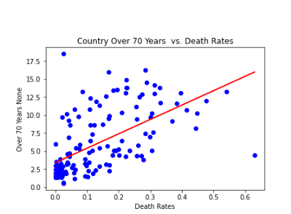
Statistically the strongest correlation of death rates per country is due to the number of the population over 65 years of age

Slide 8
HOW DID THE STRINGENCY OF THE MEASURES ENFORCED BY THE GOVERNMENT IMPACT THE SPREAD OF COVID-19 PRE VACCINATION MEASURES?

Slide 9
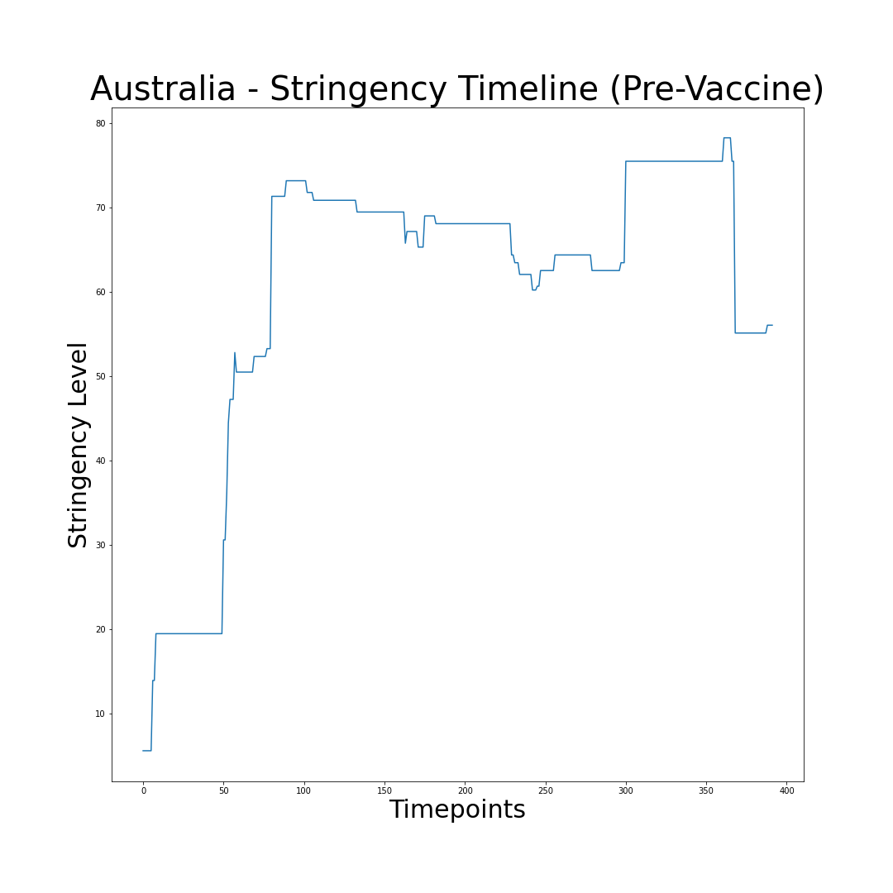
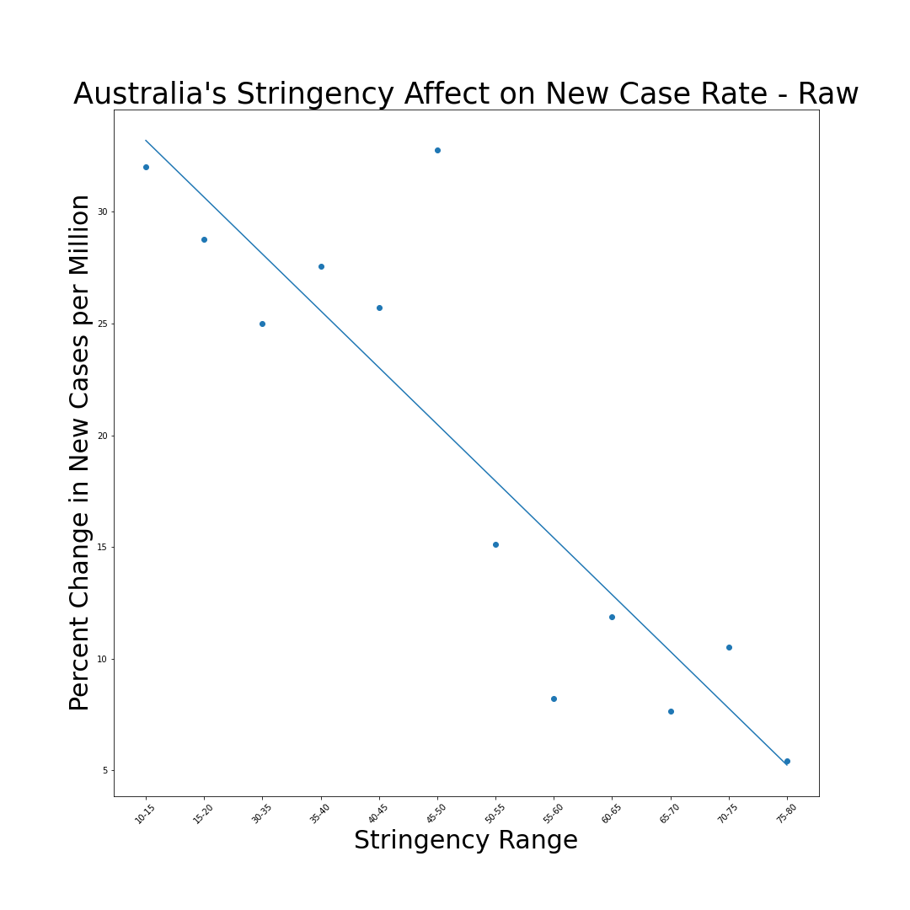
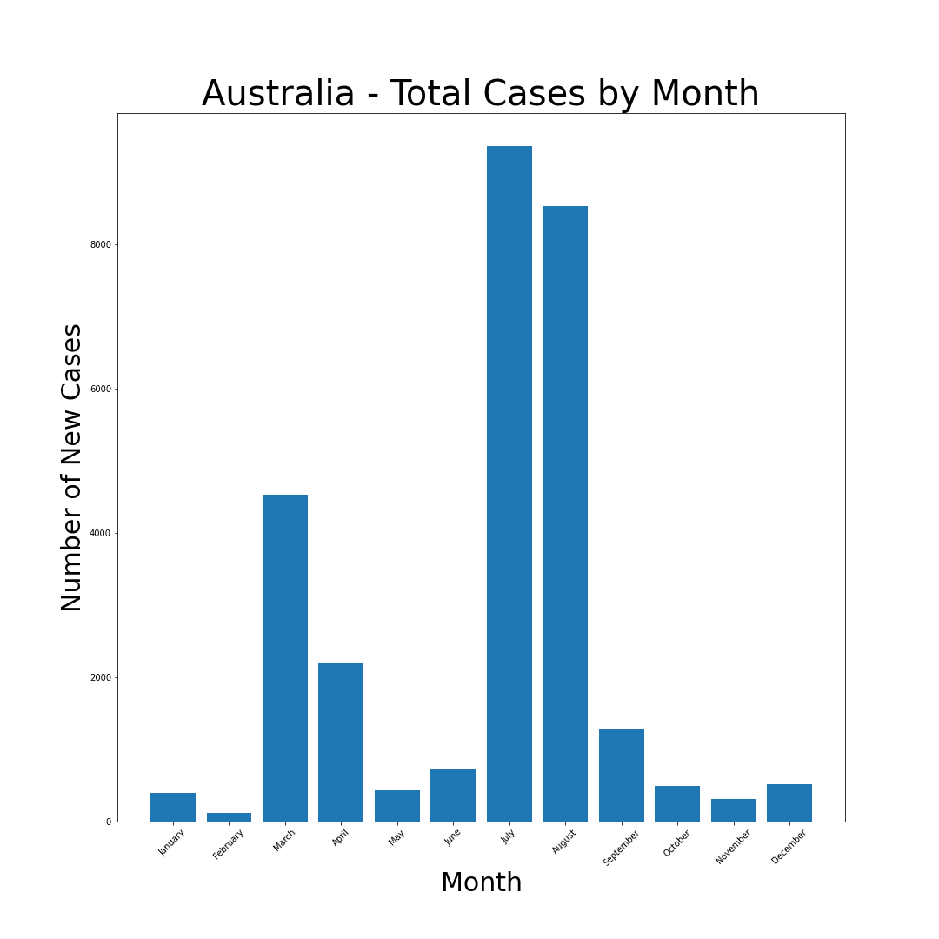
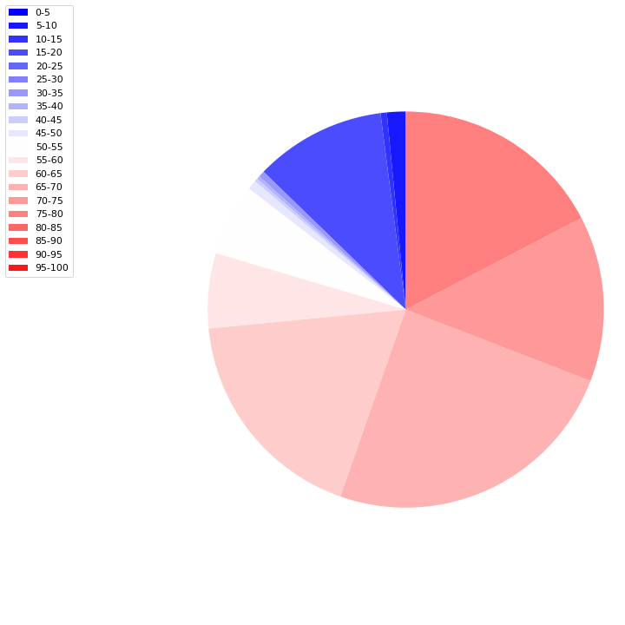
Australia
The relationship between the % change in New Cases (per million) and the enforced Stringency measures by the Government present an r value of -0.89.

Slide 10
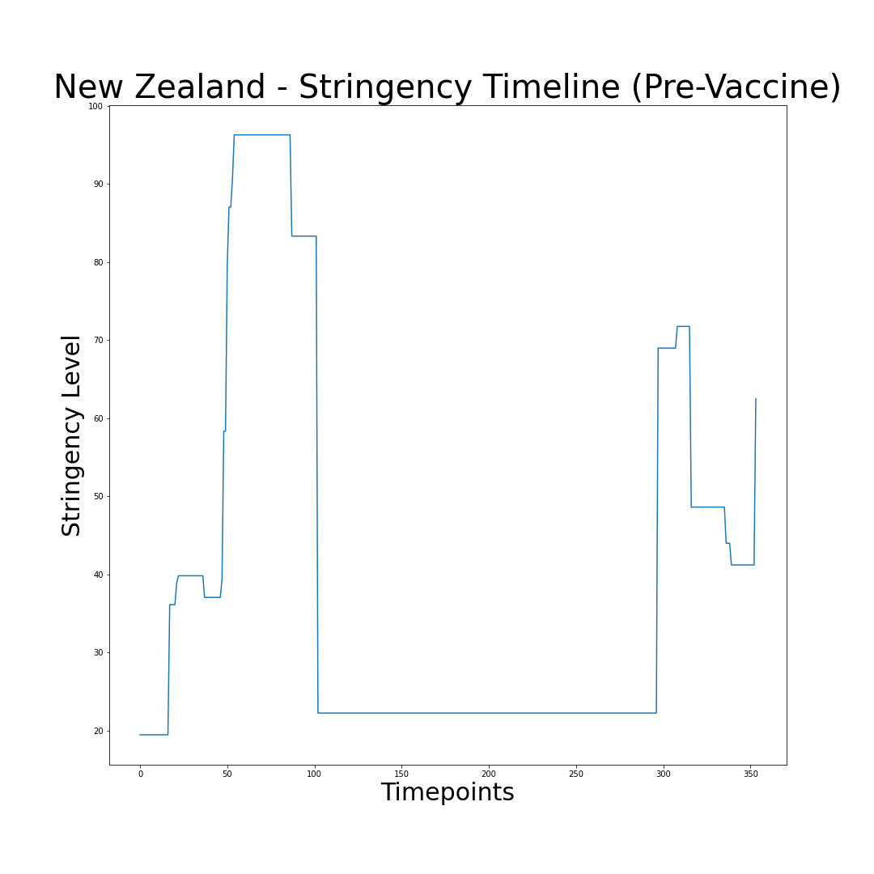
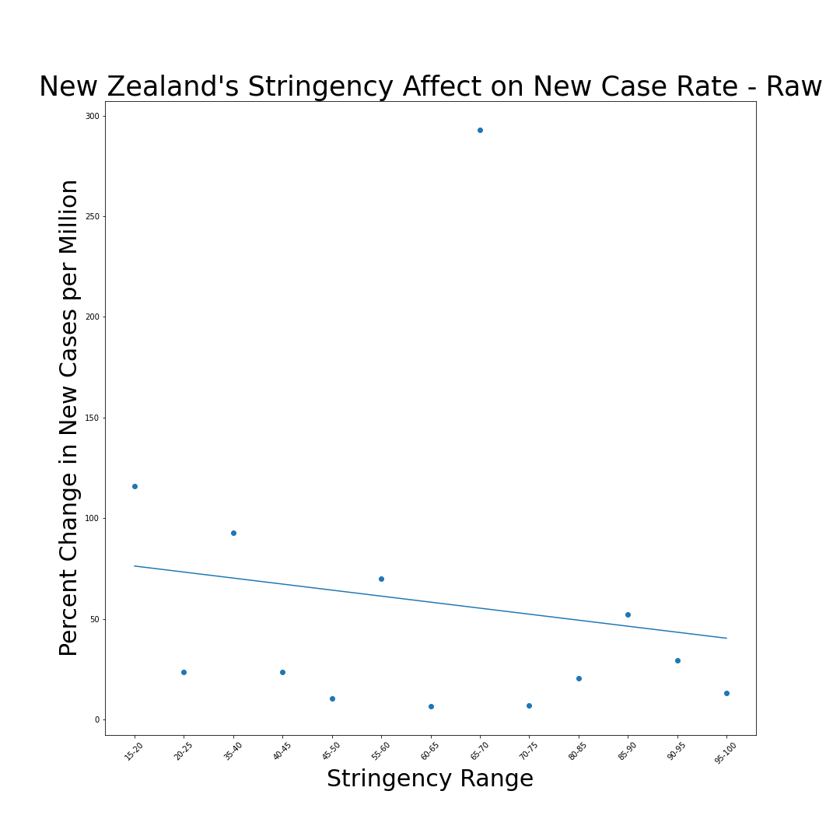
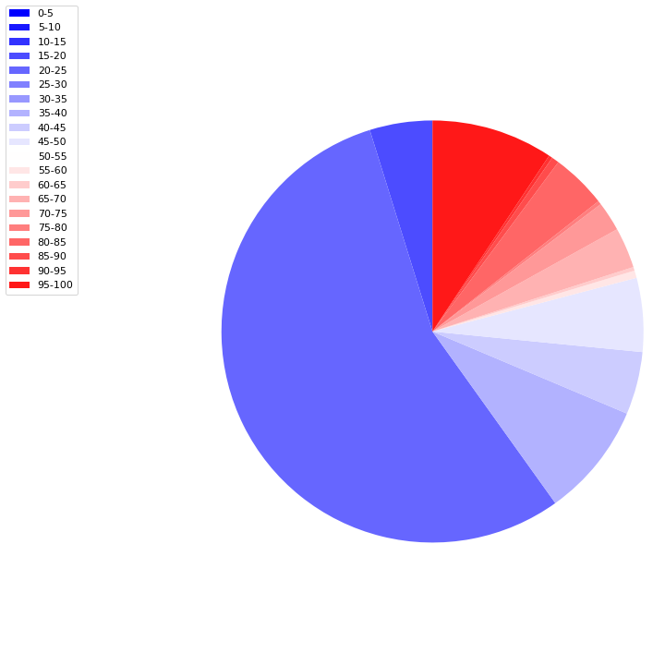
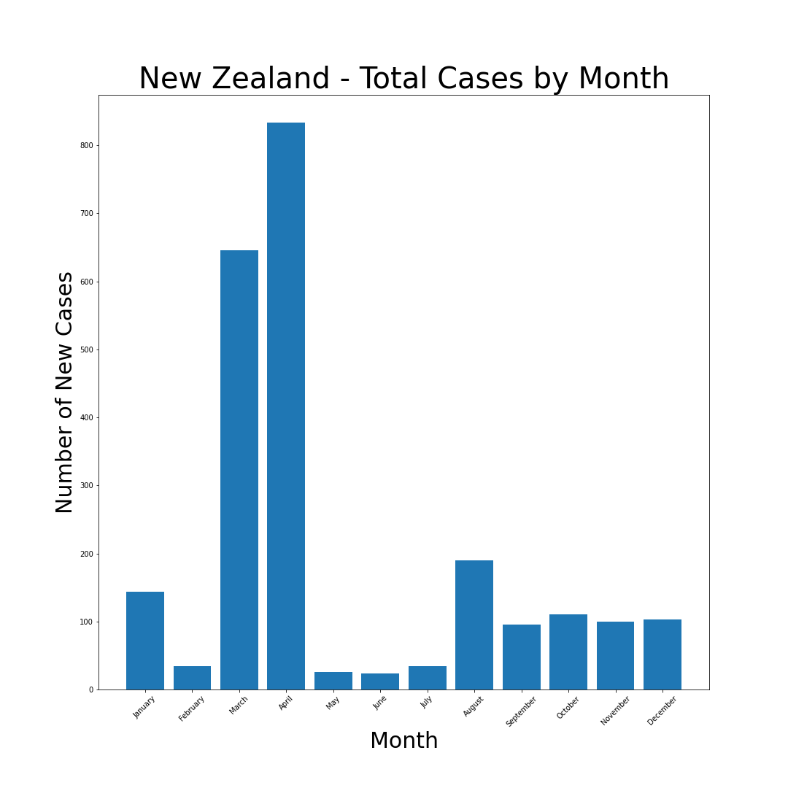
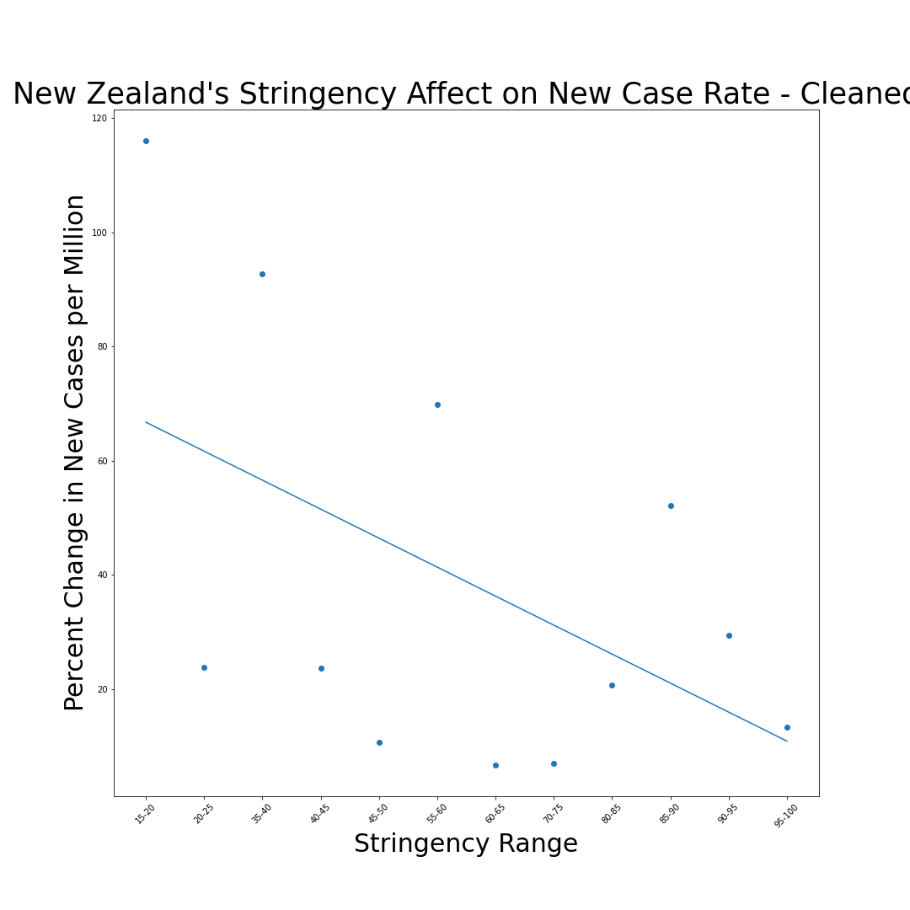
New Zealand
The relationship between the % change in New Cases (per million) and the enforced Stringency measures by the Government present an r value of -0.14 and an outlier free r value of -0.50.

Slide 11
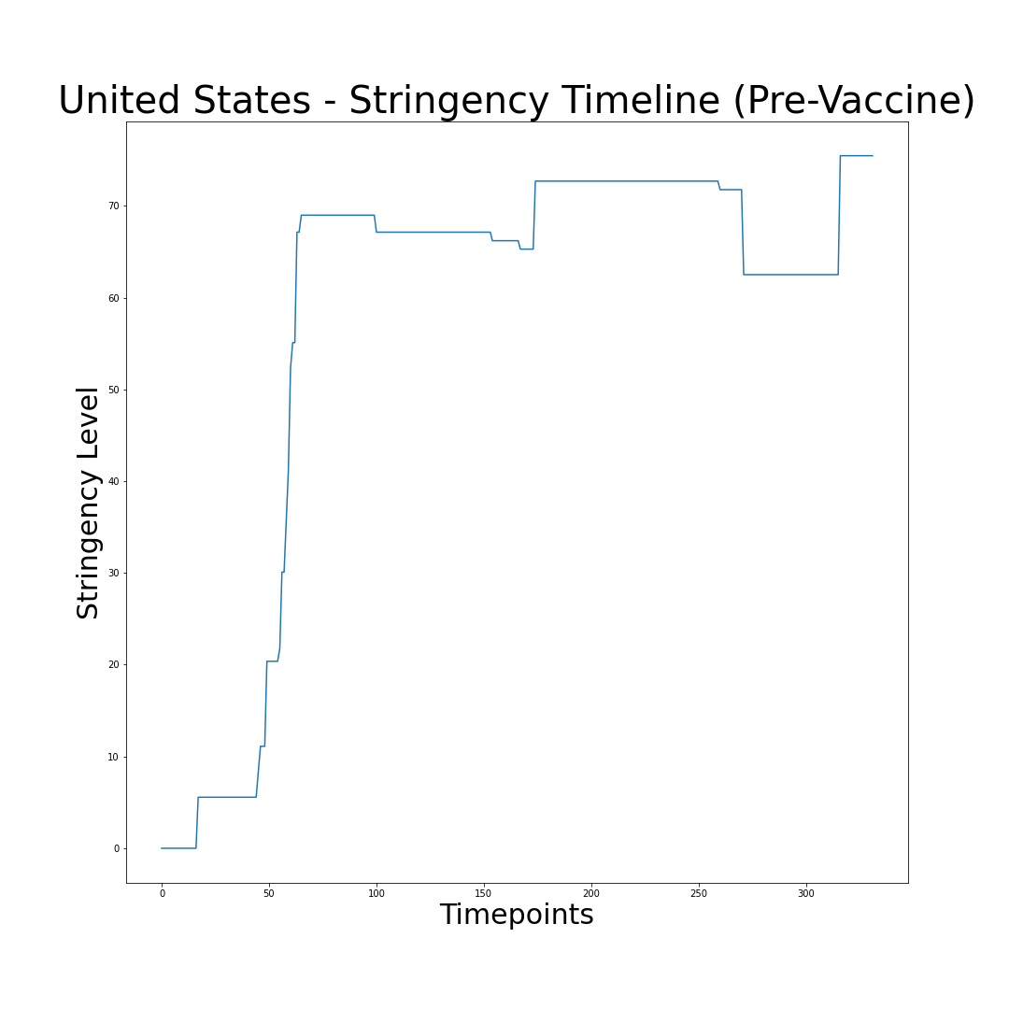
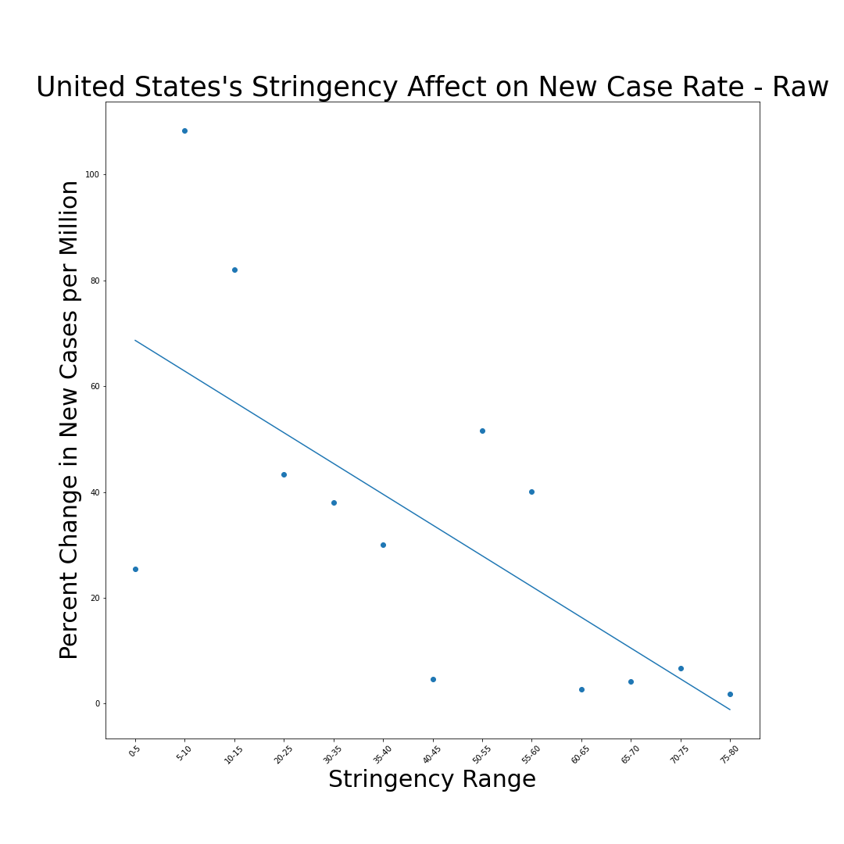
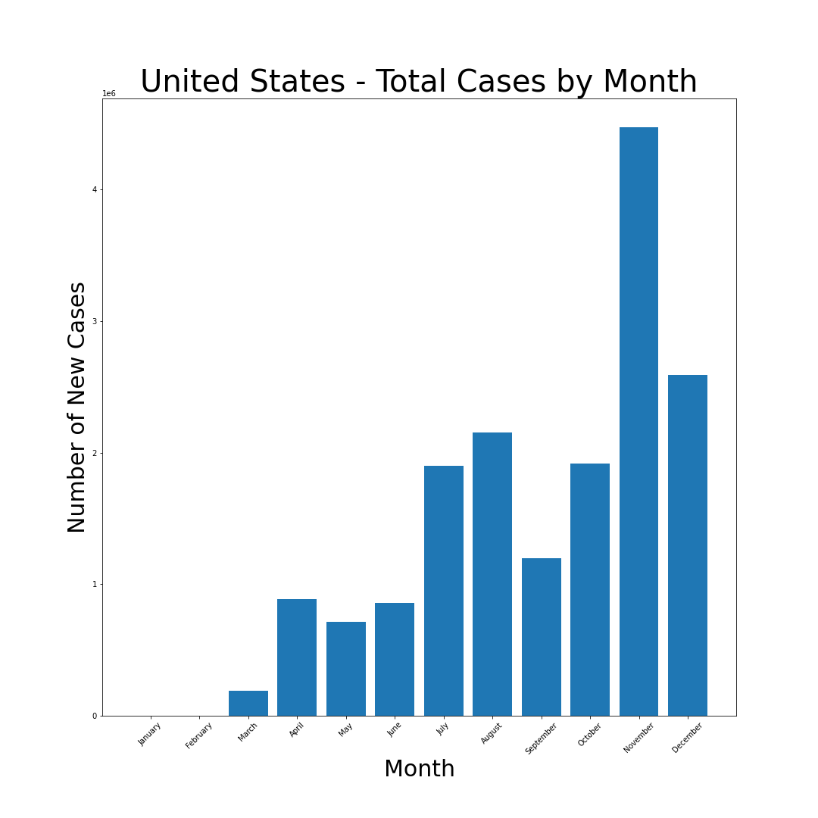
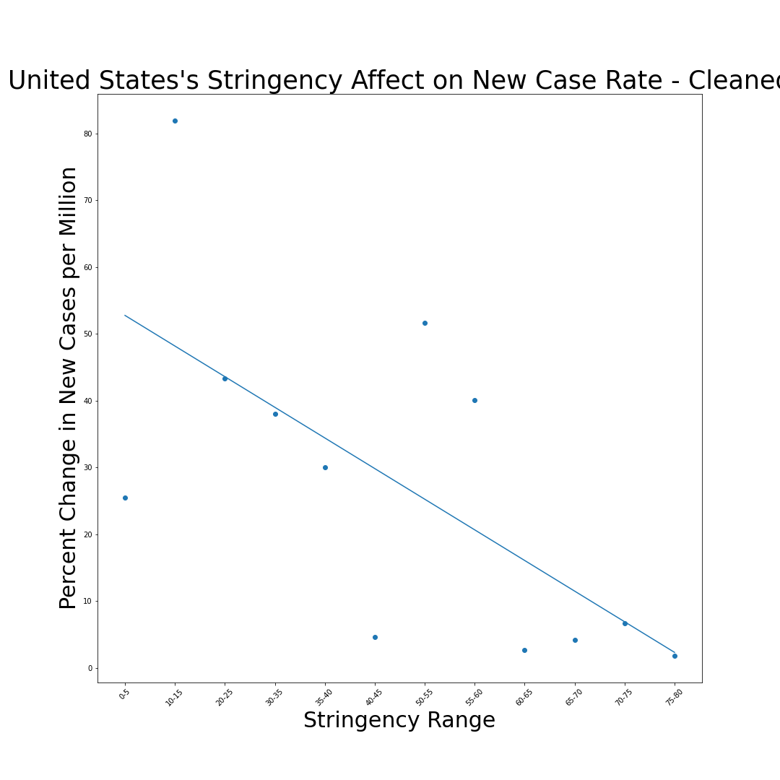
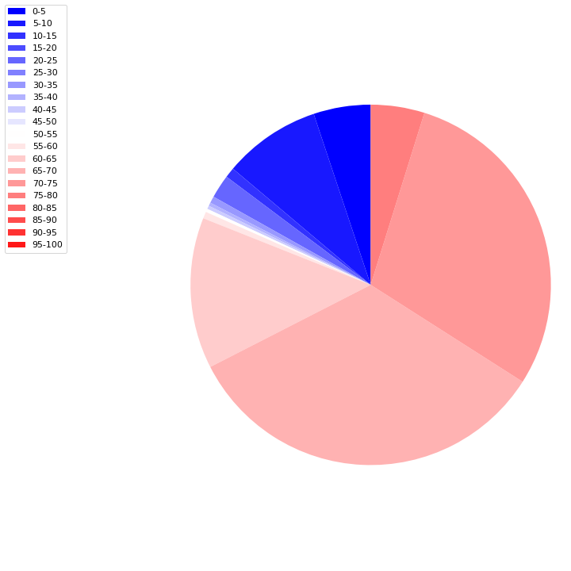
USA
The relationship between the % change in New Cases (per million) and the enforced Stringency measures by the Government present an r value of -0.14 and an outlier free r value of -0.50

Slide 12
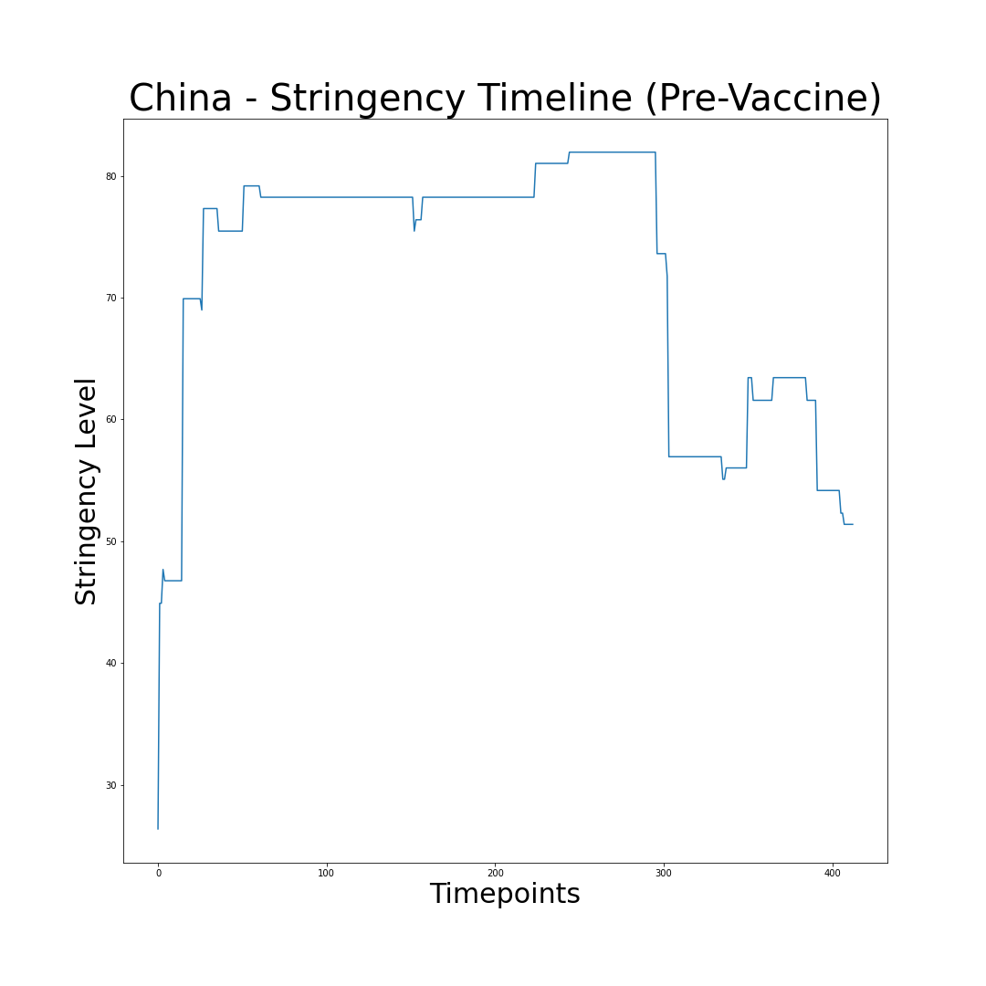
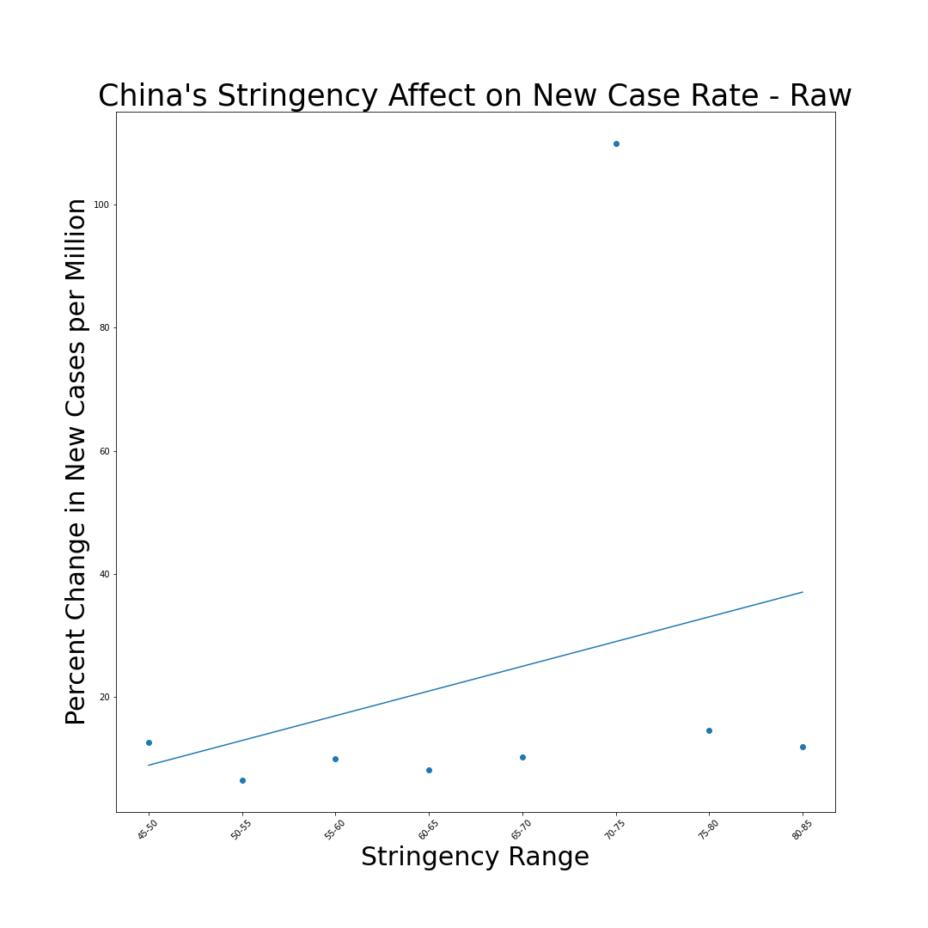
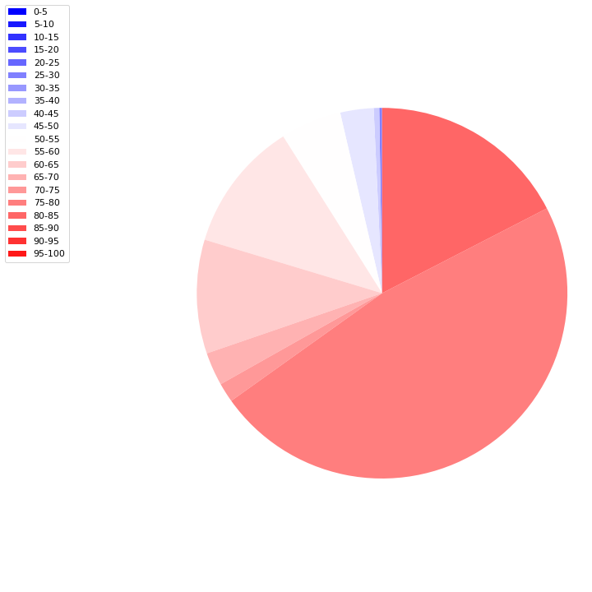
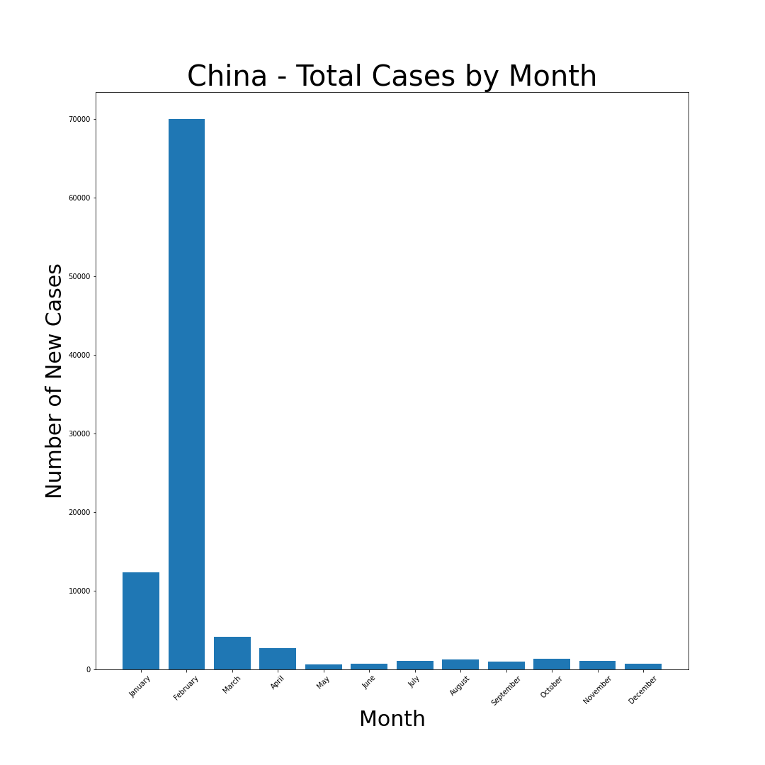
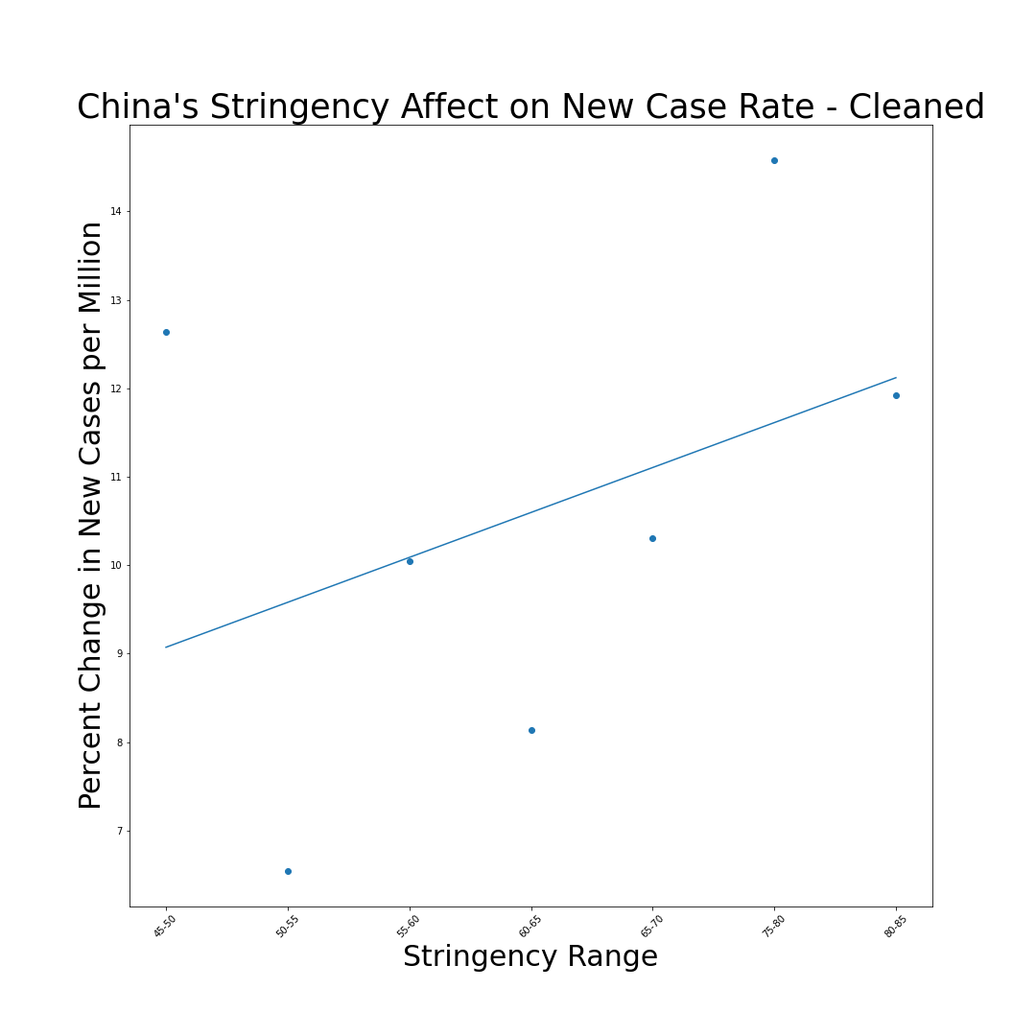
China
The relationship between the % change in New Cases (per million) and the enforced Stringency measures by the Government present an r value of -0.14 and an outlier free r value of -0.50

Slide 13
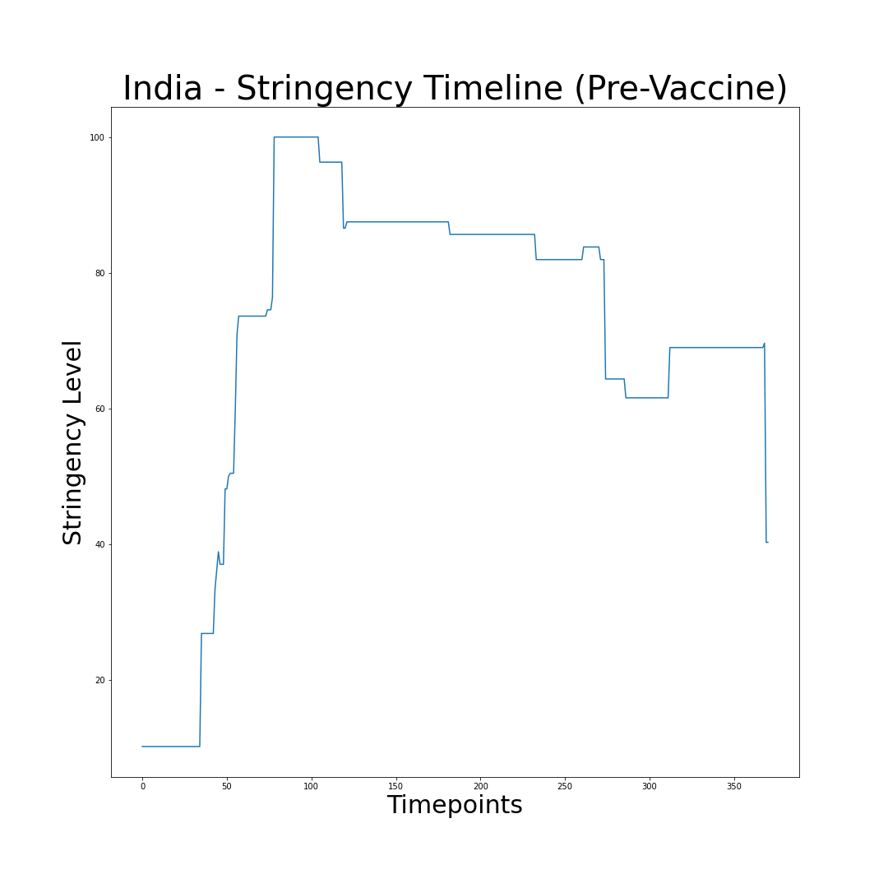
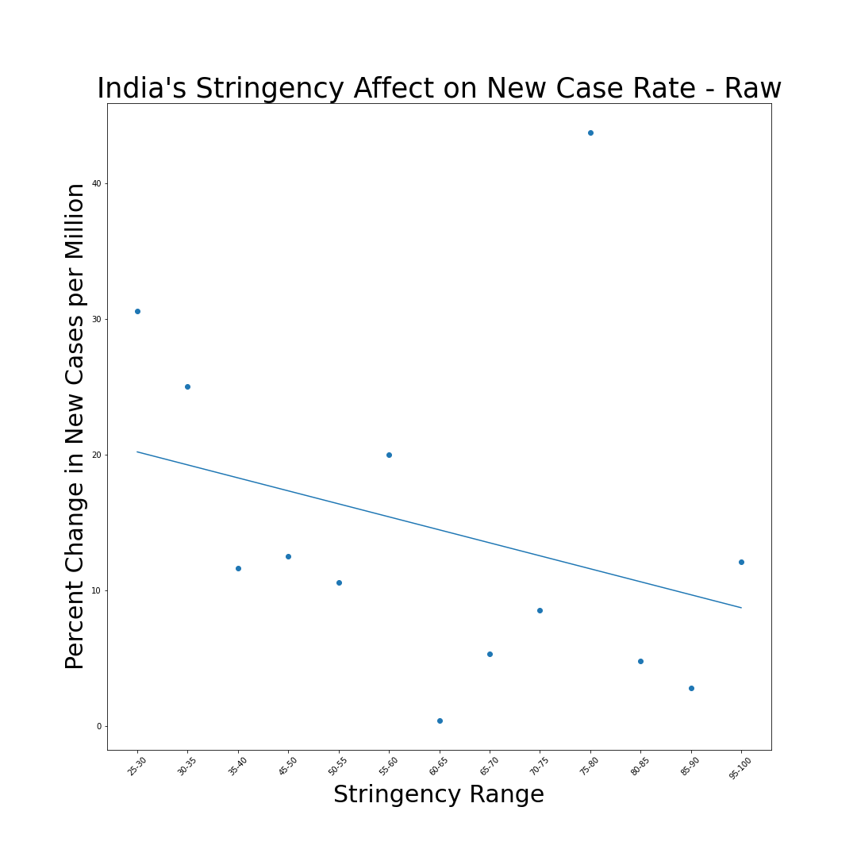
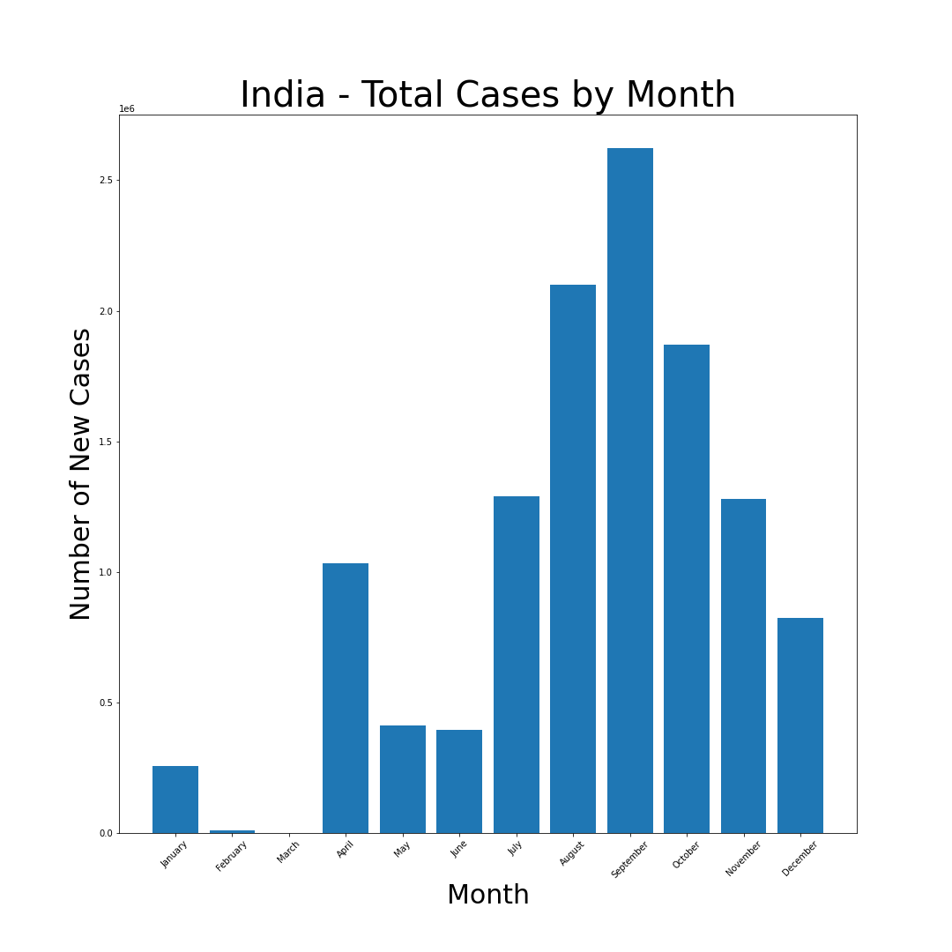
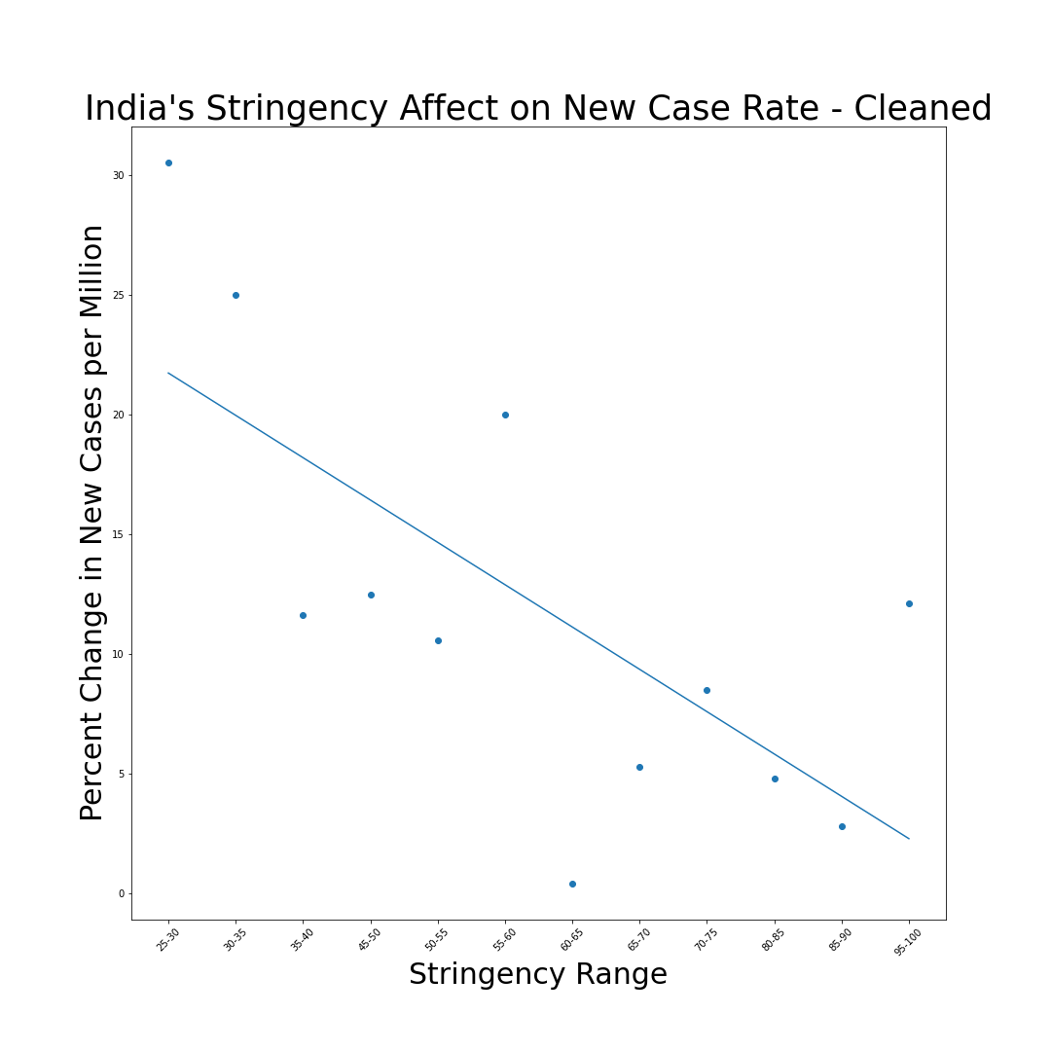
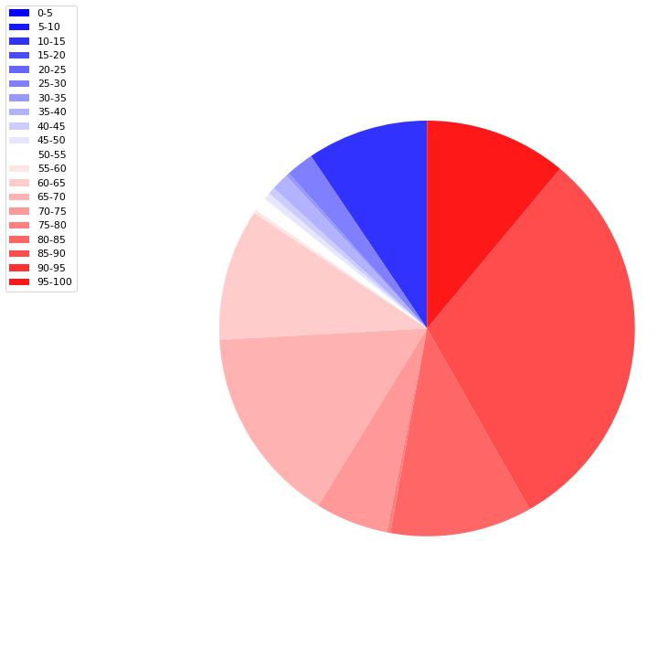
India
The relationship between the % change in New Cases (per million) and the enforced Stringency measures by the Government present an r value of -0.30 and an outlier free r value of -0.70

Slide 14
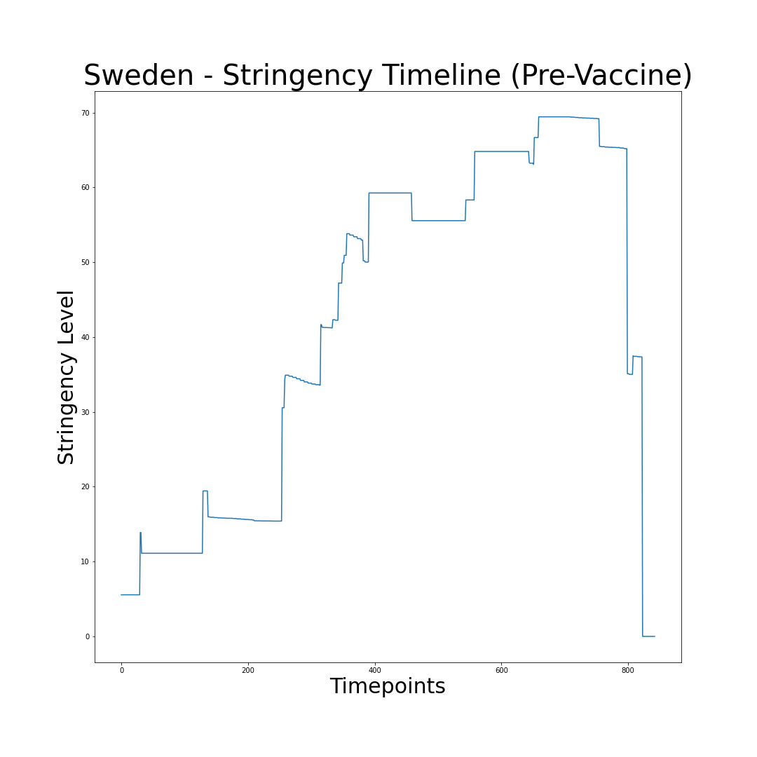
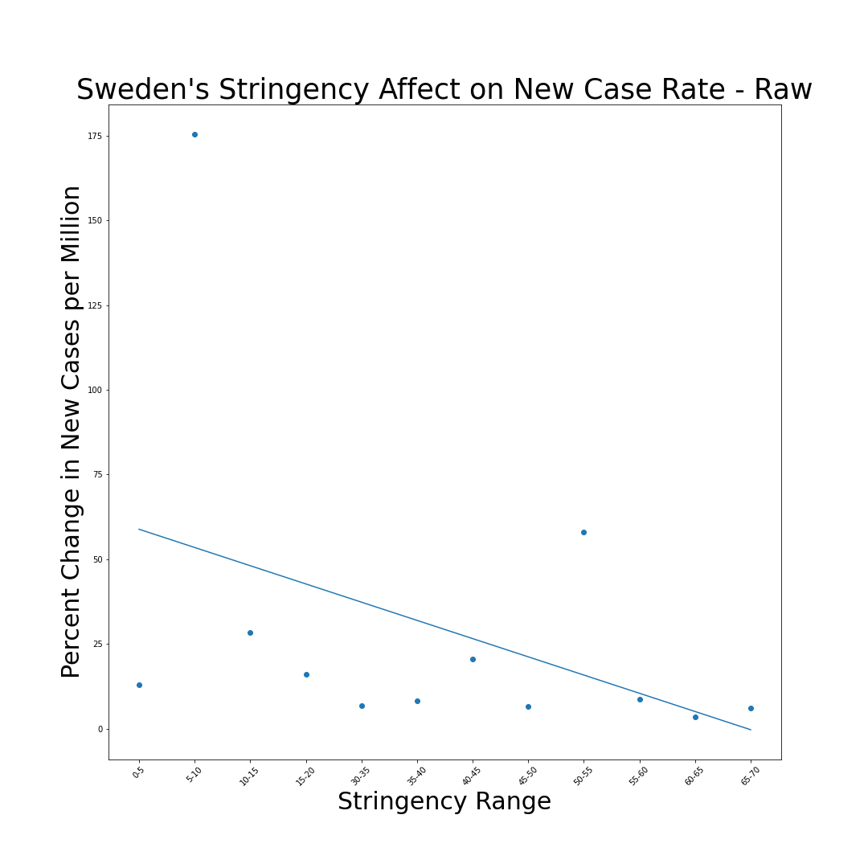
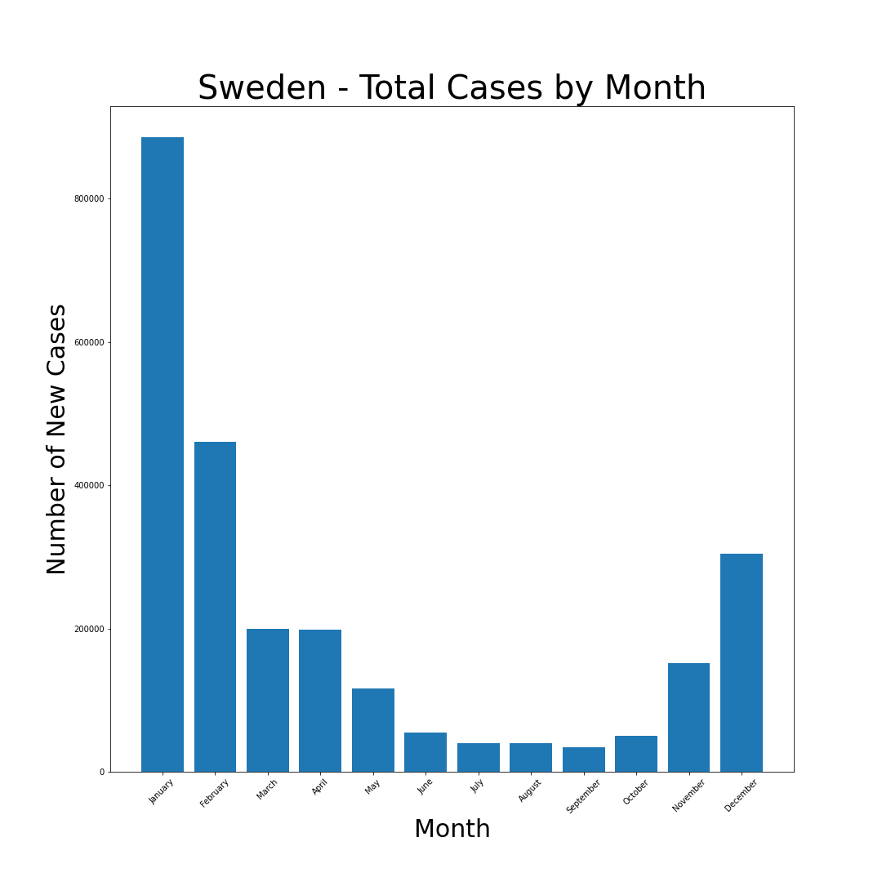
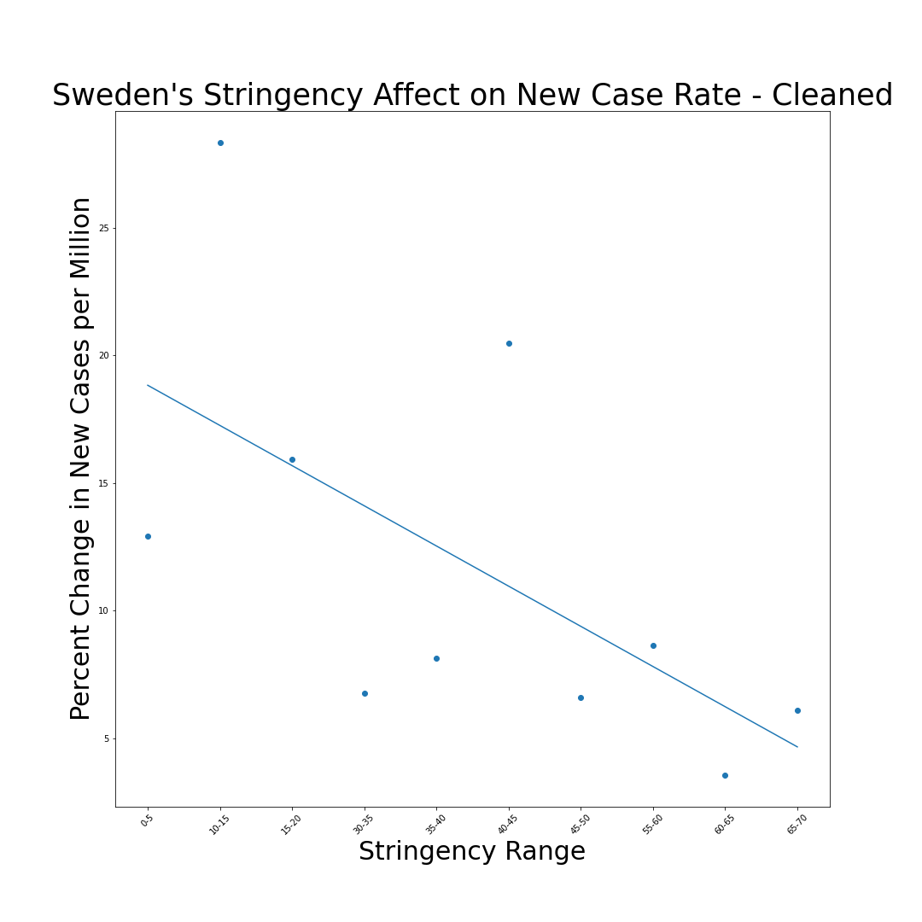
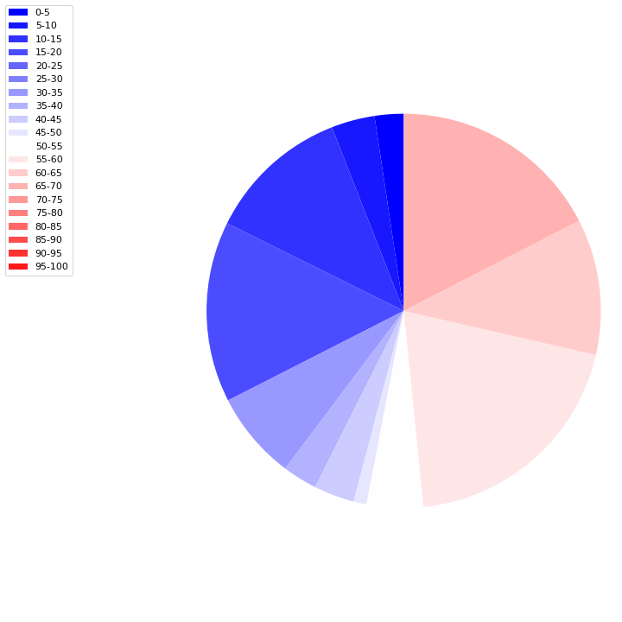
Sweden
The relationship between the % change in New Cases (per million) and the enforced Stringency measures by the Government present an r value of -0.40 and an outlier free r value of -0.61

Slide 15
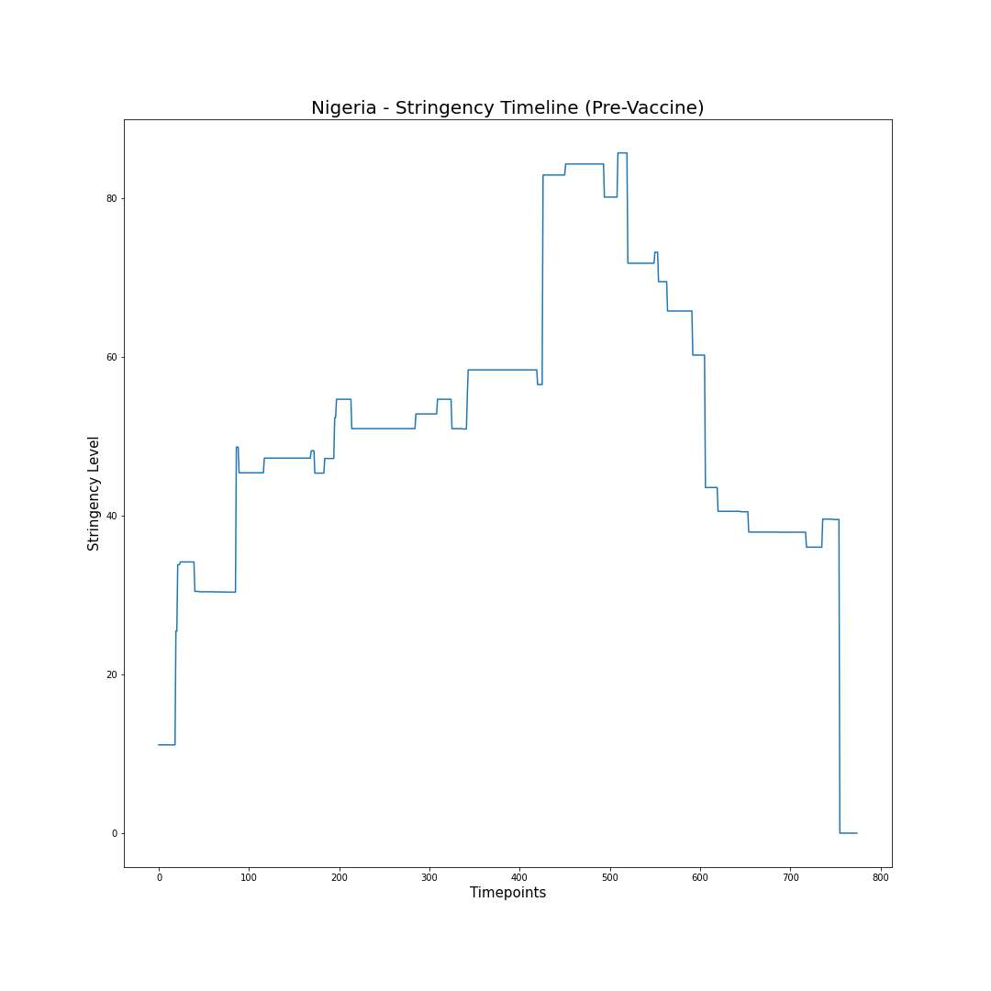
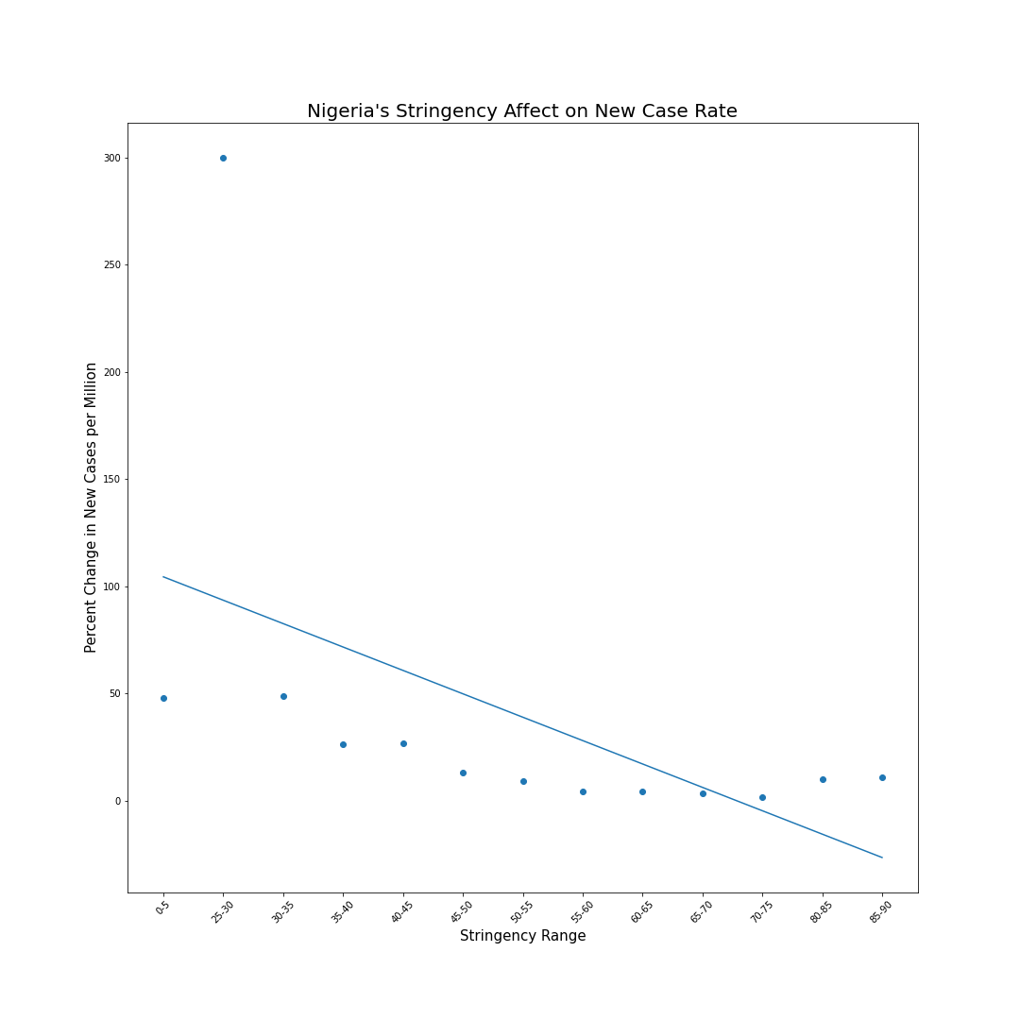
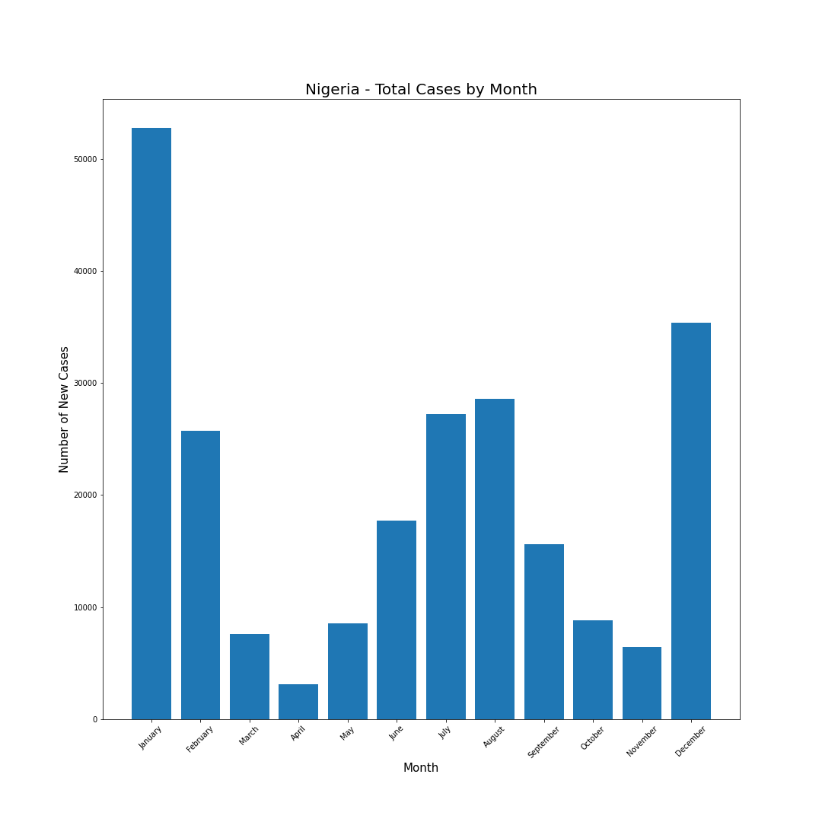
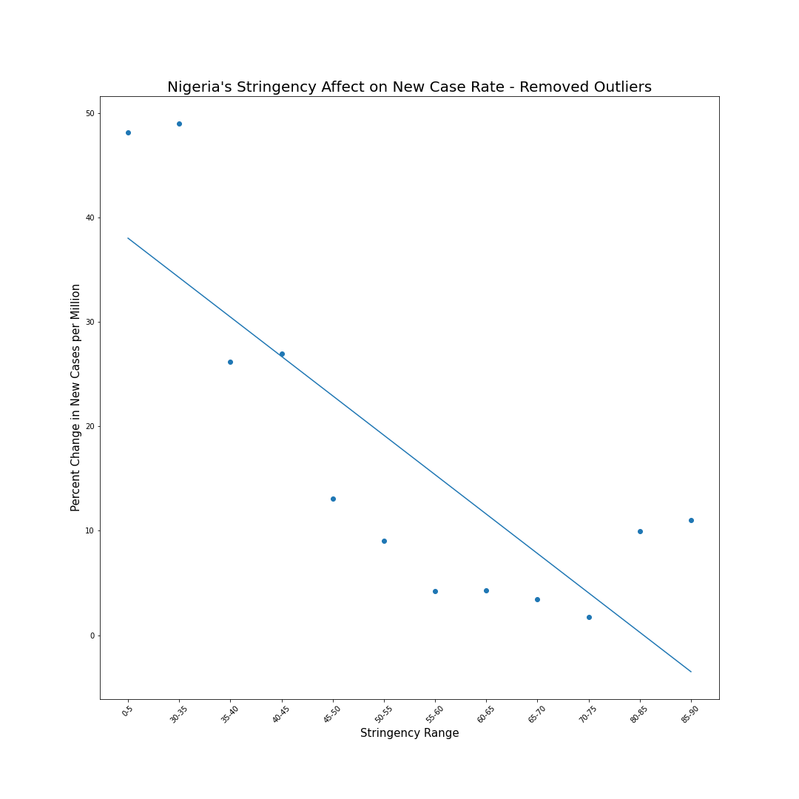
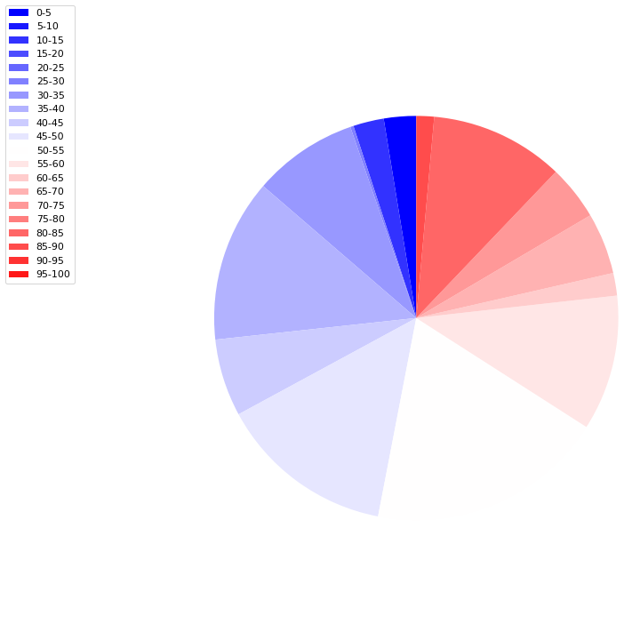
Nigeria
The relationship between the % change in New Cases (per million) and the enforced Stringency measures by the Government present an r value of -0.53 and an outlier free r value of -0.81

Slide 16
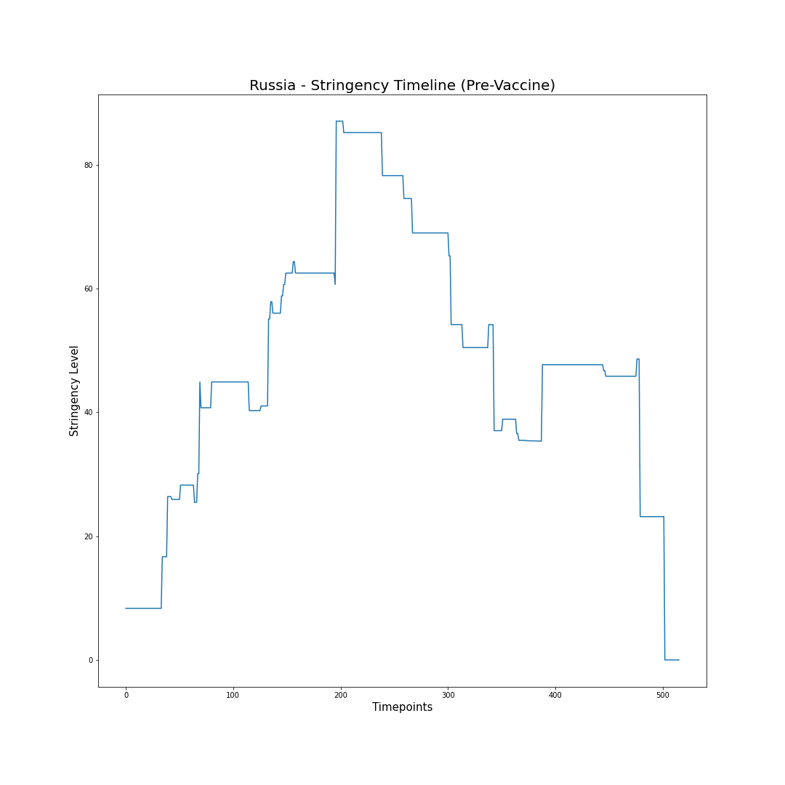
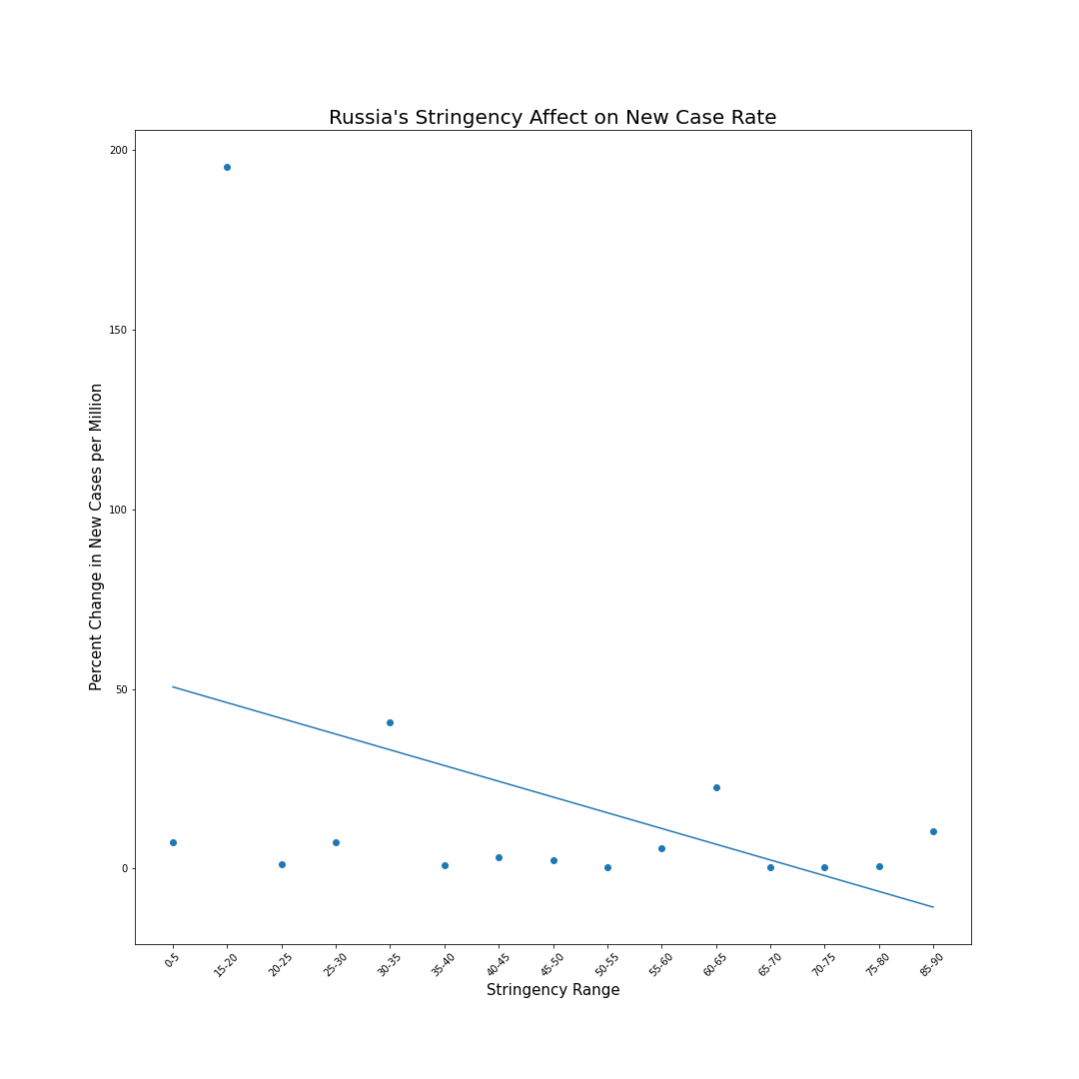
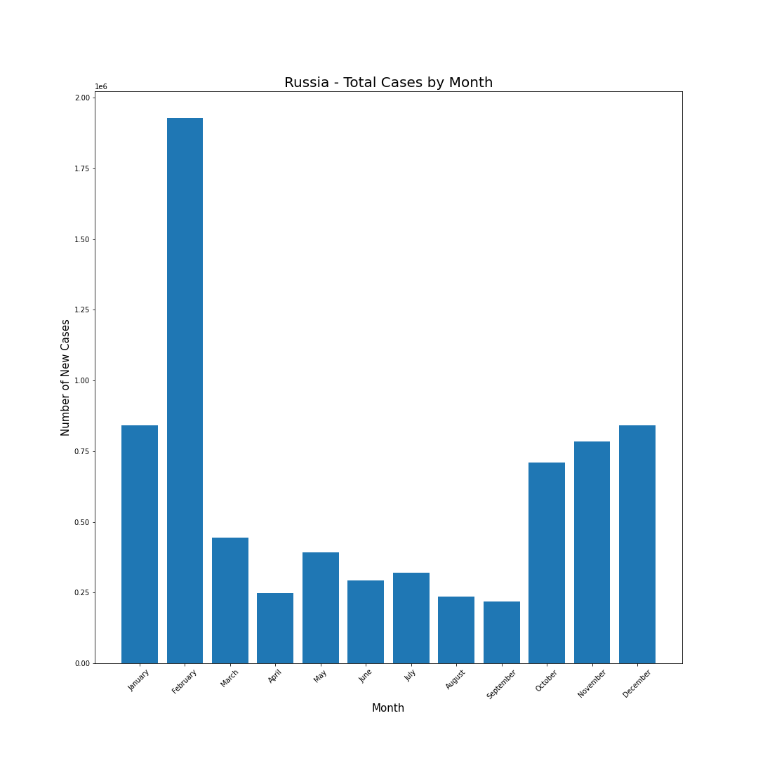
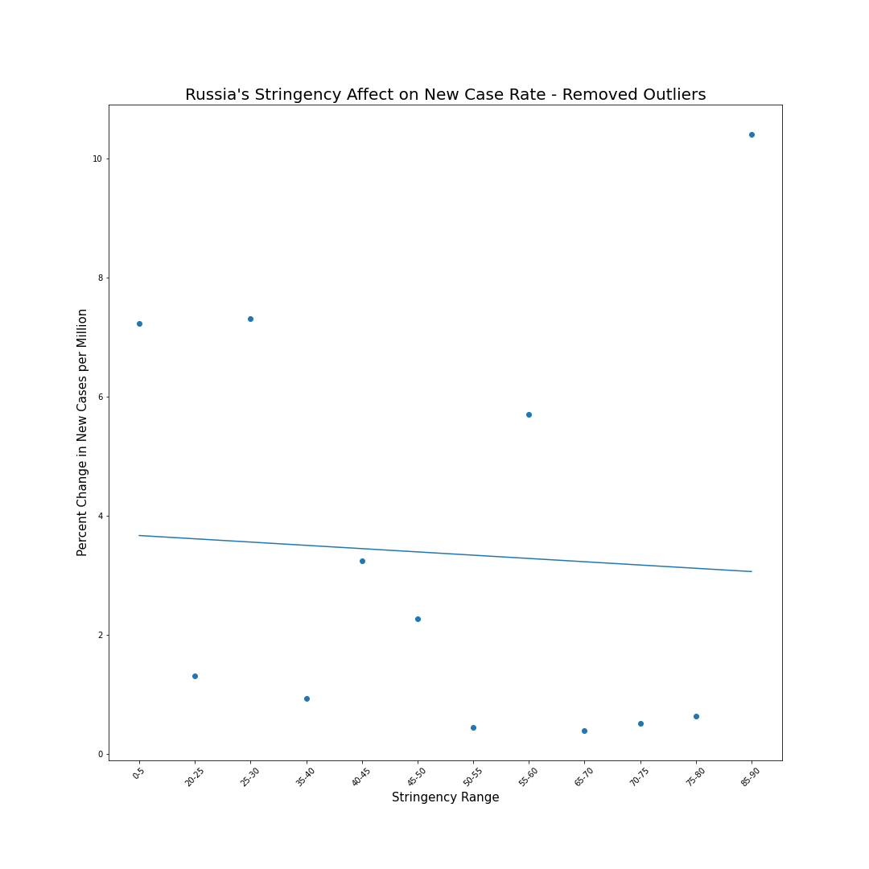
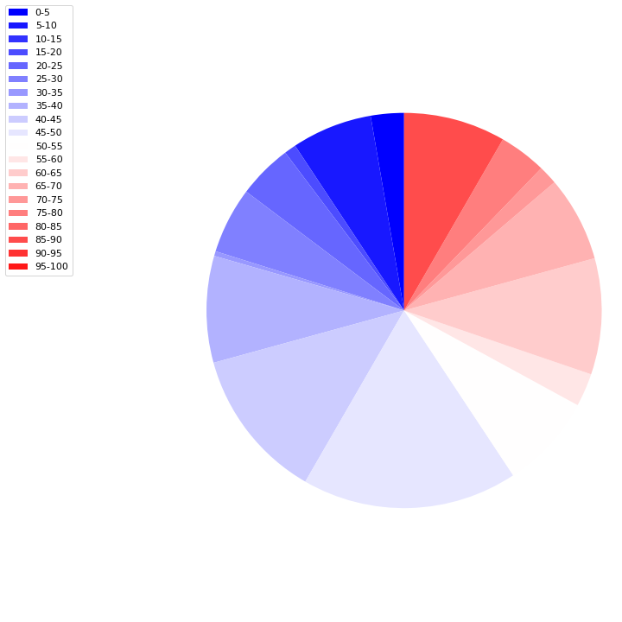
Russia
The relationship between the % change in New Cases (per million) and the enforced Stringency measures by the Government present an r value of -0.39 and an outlier free r value of -0.057

Slide 17
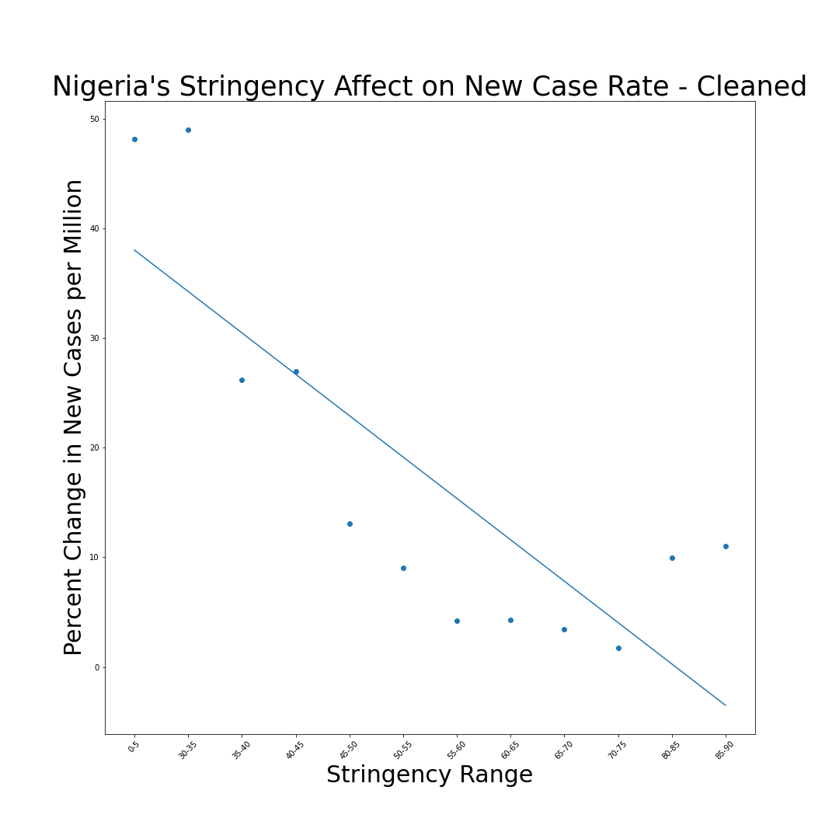
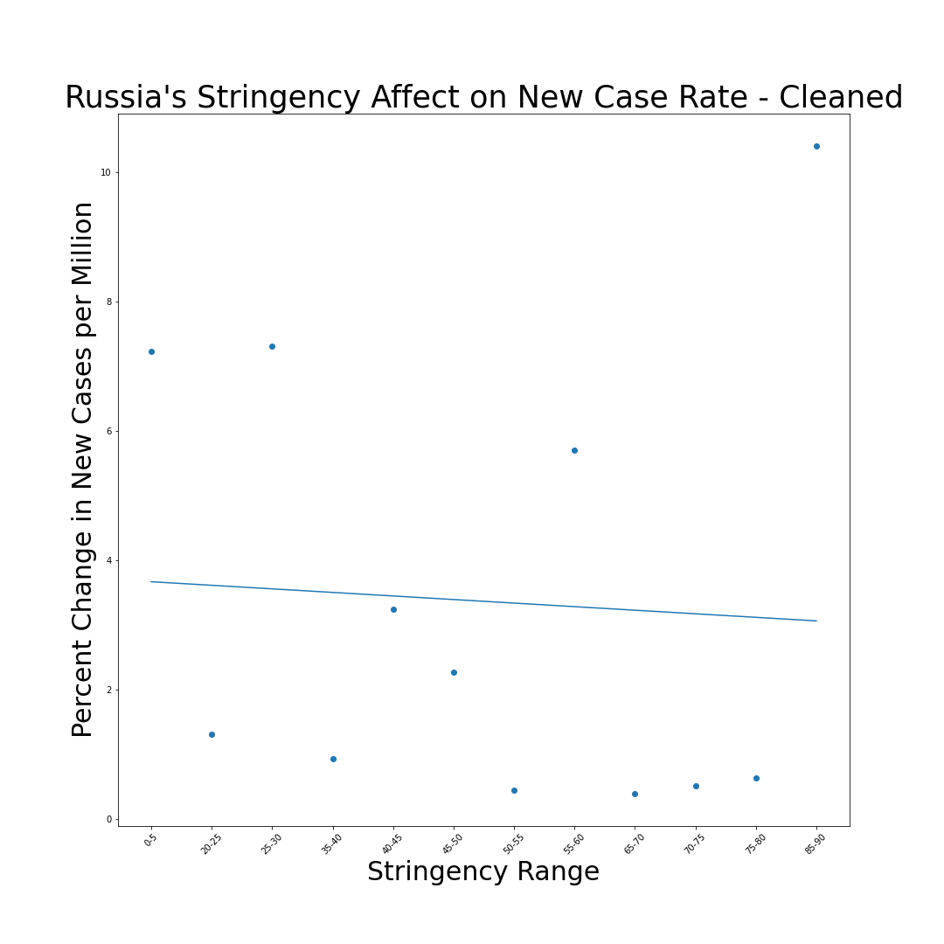
Lower Average Stringency Measures Implemented
r-value: -0.81
r-value: -0.61
r-value: -0.51
r-value: -0.06

Slide 18
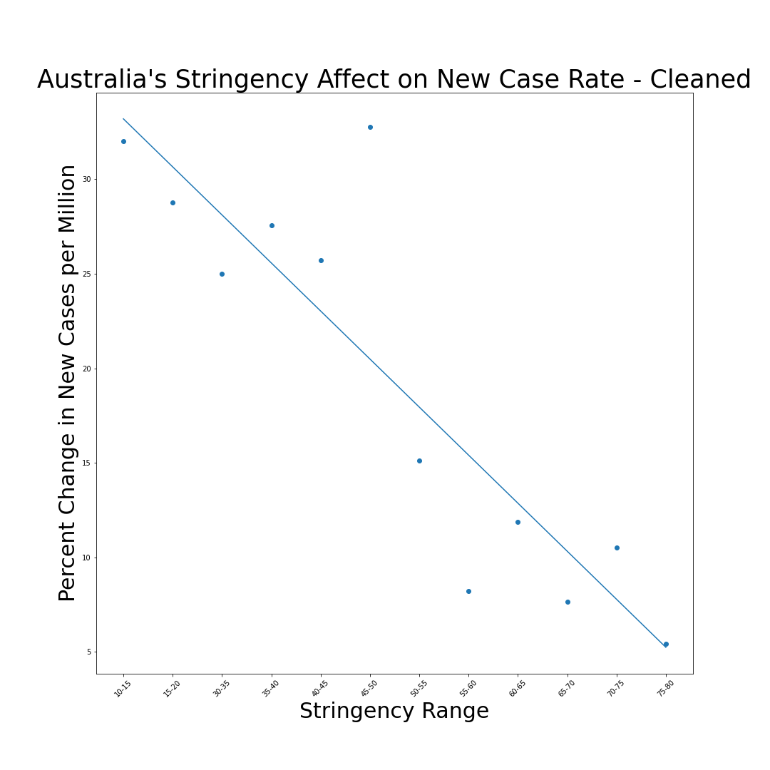
Higher Average Stringency Measures Implemented
r-value: -0.89
r-value: -0.70
r-value: -0.66
r-value: 0.40

Slide 19
HOW DID THE AVAILABILITY OF VACCINATIONS INFLUENCE THE TRENDS IN COVID-19 CASE NUMBERS AND DEATHS?

Slide 20
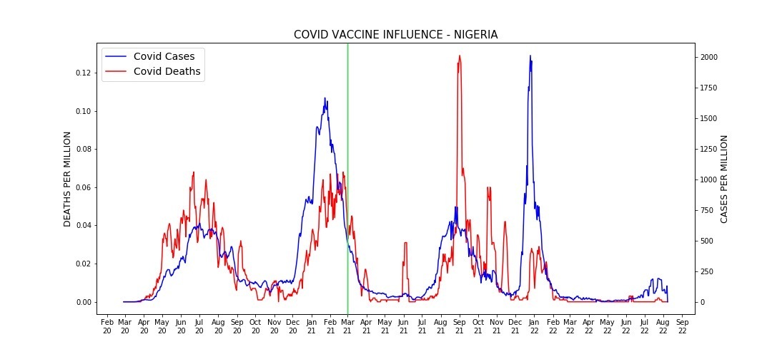

Slide 21
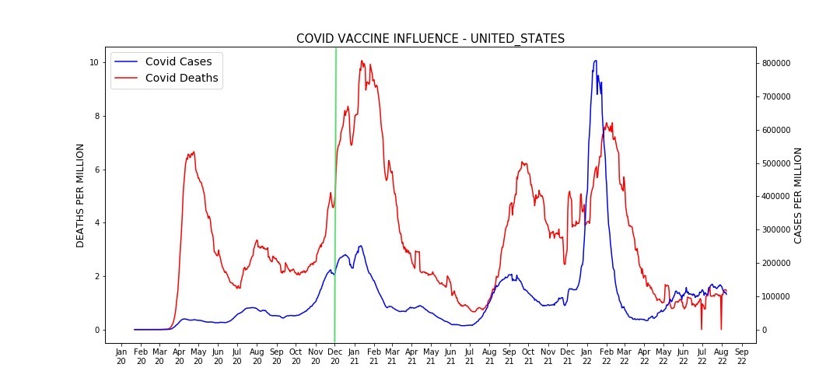

Slide 22


Slide 23


Slide 24

Questions?

